Slide 1
SD: Source Control Git
25 Apr 18 | Start
25 Apr 18 | 24
26 Apr 18 | 49
01 May 18 | 23
08 May 18 | 1: 24-28
21 Jun 18 | 1:29-34
28 Jun 18 | 1:35-43
28 Jun 18 | 2: 44-50
Appendix
Online

Slide 2
Git
Ch | Date
1 | 26 Apr 18
2
3
4
5
6
7
8
9
10
Pro Git 2014

Slide 3
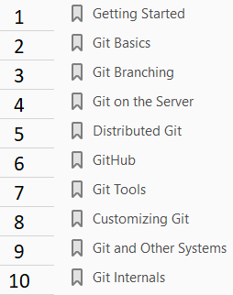

Slide 4
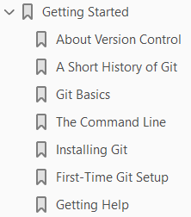
1
Getting Started

Slide 5
Intro
This chapter will be about getting started with Git.
We will begin by explaining some background on version control tools, then move on to how to get Git running on your system and finally how to get it set up to start working with.
At the end of this chapter you should understand why Git is around, why you should use it and you should be all set up to do so.

Slide 6
About Version Control
What is “version control”, and why should you care?
Version control is a system that records changes to a file or set of files over time so that you can recall specific versions later.
For the examples in this book, you will use software source code as the files being version controlled, though in reality you can do this with nearly any type of file on a computer.
If you are a graphic or web designer and want to keep every version of an image or layout (which you would most certainly want to), a Version Control System (VCS) is a very wise thing to use.
It allows you to revert selected files back to a previous state, revert the entire project back to a previous state, compare changes over time, see who last modified something that might be causing a problem, who introduced an issue and when, and more.
Using a VCS also generally means that if you screw things up or lose files, you can easily recover.
In addition, you get all this for very little overhead.

Slide 7
Local Version Control Systems
Many people’s version-control method of choice is to copy files into another directory (perhaps a time-stamped directory, if they’re clever).
This approach is very common because it is so simple, but it is also incredibly error prone.
It is easy to forget which directory you’re in and accidentally write to the wrong file or copy over files you don’t mean to.
To deal with this issue, programmers long ago developed local VCSs that had a simple database that kept all the changes to files under revision control (Figure 1).
One of the more popular VCS tools was a system called RCS, which is still distributed with many computers today.
RCS works by keeping patch sets (that is, the differences between files) in a special format on disk; it can then re-create what any file looked like at any point in time by adding up all the patches.

Slide 8
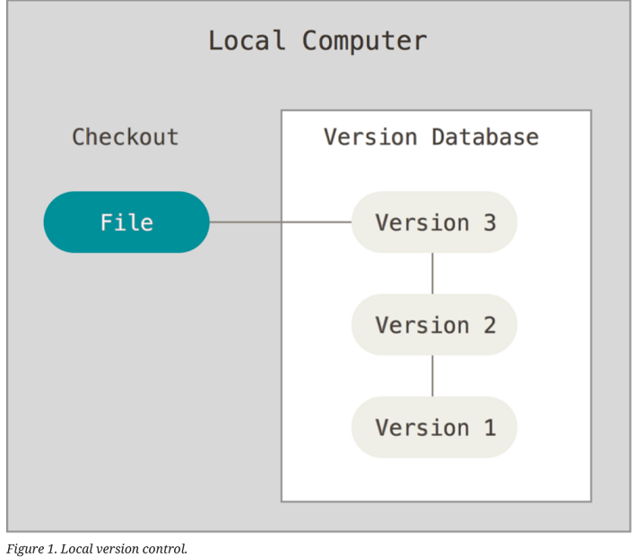
Figure 1

Slide 9
Centralized Version Control Systems
The next major issue that people encounter is that they need to collaborate with developers on other systems.
To deal with this problem, Centralized Version Control Systems (CVCSs) were developed.
These systems, such as
CVS
Subversion
Perforce
have a single server that contains all the versioned files, and a number of clients that check out files from that central place (Figure 2).
For many years, this has been the standard for version control.
This setup offers many advantages, especially over local VCSs.
For example, everyone knows to a certain degree what everyone else on the project is doing.
Administrators have fine-grained control over who can do what, and it’s far easier to administer a CVCS than it is to deal with local databases on every client.

Slide 10
Centralized Version Control Systems |
However, this setup also has some serious downsides.
The most obvious is the single point of failure that the centralized server represents.
If that server goes down for an hour, then during that hour nobody can collaborate at all or save versioned changes to anything they’re working on.
If the hard disk the central database is on becomes corrupted, and proper backups haven’t been kept, you lose absolutely everything — the entire history of the project except whatever single snapshots people happen to have on their local machines.
Local VCS systems suffer from this same problem — whenever you have the entire history of the project in a single place, you risk losing everything.

Slide 11
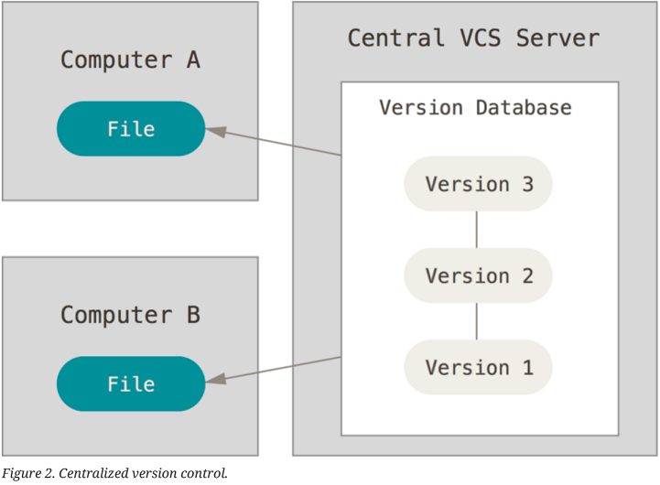
Figure 2

Slide 12
Distributed Version Control Systems
This is where Distributed Version Control Systems (DVCSs) step in.
In a DVCS clients don’t just check out the latest snapshot of the files; rather, they fully mirror the repository, including its full history.
Examples of DVC Clients:
Git Mercurial
Bazaar Darcs
Thus, if any server dies, and these systems were collaborating via that server, any of the client repositories can be copied back up to the server to restore it (Figure 3).
Every clone is really a full backup of all the data.
Furthermore, many of these systems deal pretty well with having several remote repositories they can work with, so you can collaborate with different groups of people in different ways simultaneously within the same project.
This allows you to set up several types of workflows that aren’t possible in centralized systems, such as hierarchical models.

Slide 13
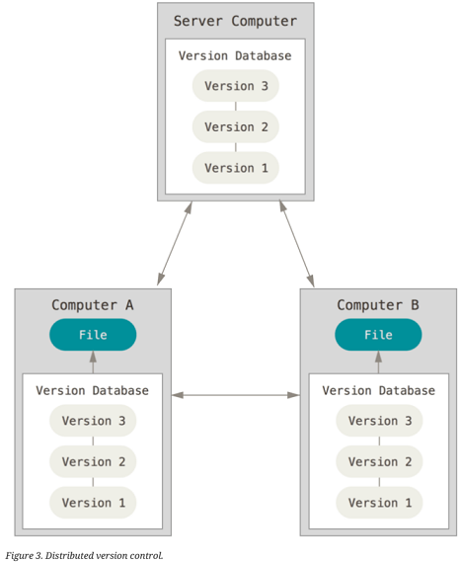
Figure 3

Slide 14
A Short History of Git
As with many great things in life, Git began with a bit of creative destruction and fiery controversy.
The Linux kernel is an open source software project of fairly large scope.
For most of the lifetime of the Linux kernel maintenance (1991–2002), changes to the software were passed around as patches and archived files.
In 2002, the Linux kernel project began using a proprietary DVCS called BitKeeper.
In 2005, the relationship between the community that developed the Linux kernel and the commercial company that developed BitKeeper broke down, and the tool’s free-of-charge status was revoked.
This prompted the Linux development community (and in particular Linus Torvalds, the creator of Linux) to develop their own tool based on some of the lessons they learned while using BitKeeper.
Some of the goals of the new system were as follows:
Speed
Simple design
Strong support for non-linear development (thousands of parallel branches)
Fully distributed

Slide 15
A Short History of Git |
Able to handle large projects like the Linux kernel efficiently (speed and data size)
Since its birth in 2005, Git has evolved and matured to be easy to use and yet retain these initial qualities.
It’s amazingly fast, it’s very efficient with large projects, and it has an incredible branching system for non-linear development (See Git Branching).

Slide 16
Git Basics
So, what is Git in a nutshell? This is an important section to absorb, because if you understand what Git is and the fundamentals of how it works, then using Git effectively will probably be much easier for you.
As you learn Git, try to clear your mind of the things you may know about other VCSs, such as CVS, Subversion or Perforce — doing so will help you avoid subtle confusion when using the tool.
Even though Git’s user interface is fairly similar to these other VCSs, Git stores and thinks about information in a very different way, and understanding these differences will help you avoid becoming confused while using it.

Slide 17
Snapshots, Not Differences
The major difference between Git and any other VCS (Subversion and friends included) is the way Git thinks about its data.
Conceptually, most other systems store information as a list of file-based changes.
These other systems (CVS, Subversion, Perforce, Bazaar, and so on) think of the information they store as a set of files and the changes made to each file over time (this is commonly described as delta-based version control) – Figure 4.
Git doesn’t think of or store its data this way. Instead, Git thinks of its data more like a series of snapshots of a miniature filesystem.
With Git, every time you commit, or save the state of your project, Git basically takes a picture of what all your files look like at that moment and stores a reference to that snapshot.
To be efficient, if files have not changed, Git doesn’t store the file again, just a link to the previous identical file it has already stored.
Git thinks about its data more like a stream of snapshots.
This is an important distinction between Git and nearly all other VCSs.
It makes Git reconsider almost every aspect of version control that most other systems copied from the previous generation.

Slide 18
Snapshots, Not Differences |
This makes Git more like a mini filesystem with some incredibly powerful tools built on top of it, rather than simply a VCS.
We’ll explore some of the benefits you gain by thinking of your data this way when we cover Git branching in Git Branching.

Slide 19
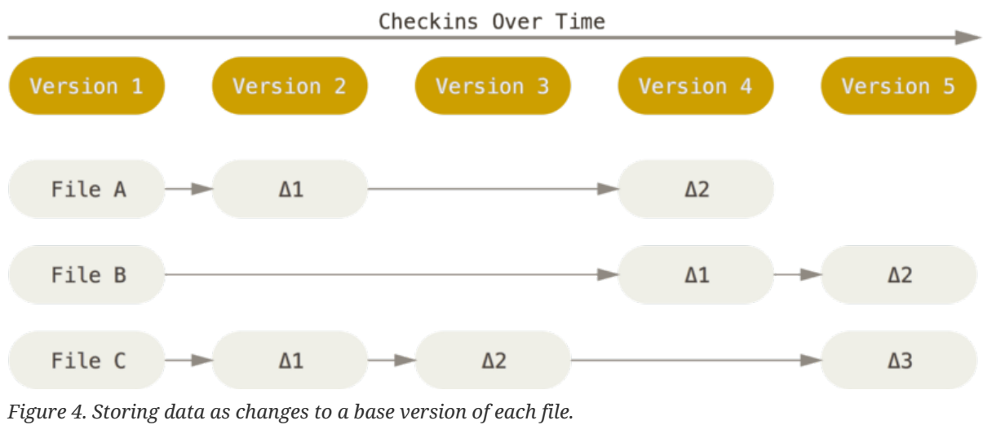
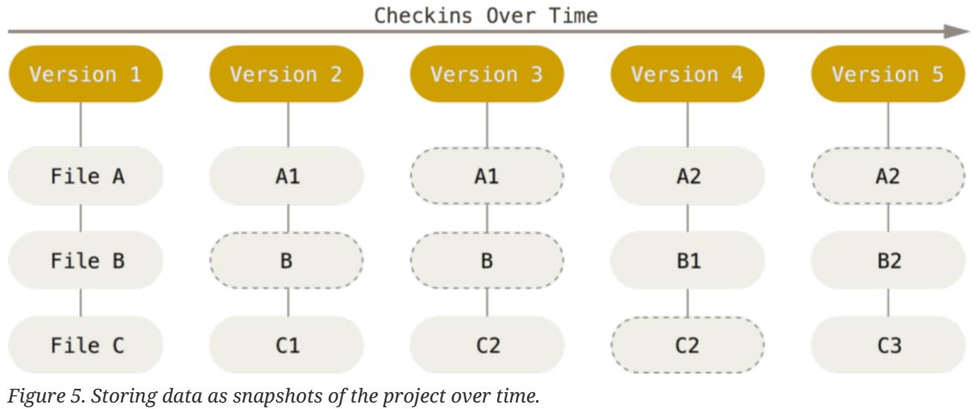
Figure 4 || Figure 5

Slide 20
Nearly Every Operation Is Local
Most operations in Git need only local files and resources to operate — generally no information is needed from another computer on your network.
If you’re used to a CVCS where most operations have that network latency overhead, this aspect of Git will make you think that the gods of speed have blessed Git with unworldly powers.
Because you have the entire history of the project right there on your local disk, most operations seem almost instantaneous.
For example, to browse the history of the project, Git doesn’t need to go out to the server to get the history and display it for you — it simply reads it directly from your local database.
This means you see the project history almost instantly.
If you want to see the changes introduced between the current version of a file and the file a month ago, Git can look up the file a month ago and do a local difference calculation, instead of having to either ask a remote server to do it or pull an older version of the file from the remote server to do it locally.
This also means that there is very little you can’t do if you’re offline or off VPN.
If you get on an airplane or a train and want to do a little work, you can commit happily (to your local copy, remember?) until you get to a network connection to upload.

Slide 21
Nearly Every Operation Is Local |
If you go home and can’t get your VPN client working properly, you can still work. In many other systems, doing so is either impossible or painful.
In Perforce, for example, you can’t do much when you aren’t connected to the server; and in Subversion and CVS, you can edit files, but you can’t commit changes to your database (because your database is offline).
This may not seem like a huge deal, but you may be surprised what a big difference it can make.

Slide 22
Git Has Integrity
Everything in Git is check-summed before it is stored and is then referred to by that checksum.
This means it’s impossible to change the contents of any file or directory without Git knowing about it.
This functionality is built into Git at the lowest levels and is integral to its philosophy.
You can’t lose information in transit or get file corruption without Git being able to detect it.
The mechanism that Git uses for this checksumming is called a SHA-1 hash.
This is a 40-character string composed of hexadecimal characters (0–9 and a–f) and calculated based on the contents of a file or directory structure in Git.
A SHA-1 hash looks something like this:
You will see these hash values all over the place in Git because it uses them so much.
In fact, Git stores everything in its database not by file name but by the hash value of its contents.

Slide 23
Git Generally Only Adds Data
When you do actions in Git, nearly all of them only add data to the Git database.
It is hard to get the system to do anything that is not undoable or to make it erase data in any way.
As with any VCS, you can lose or mess up changes you haven’t committed yet, but after you commit a snapshot into Git, it is very difficult to lose, especially if you regularly push your database to another repository.
This makes using Git a joy because we know we can experiment without the danger of severely screwing things up.
For a more in-depth look at how Git stores its data and how you can recover data that seems lost, see Undoing Things.

Slide 24
The Three States
Pay attention now — here is the main thing to remember about Git if you want the rest of your learning process to go smoothly.
Git has three main states that your files can reside in:
Committed Modified Staged
Committed means that the data is safely stored in your local database.
Modified means that you have changed the file but have not committed it to your database yet.
Staged means that you have marked a modified file in its current version to go into your next commit snapshot.
This leads us to the three main sections of a Git project: Figure - 6
the Git directory
the working tree
the staging area

Slide 25
The Three States |
The Git directory is where Git stores the metadata and object database for your project.
This is the most important part of Git, and it is what is copied when you clone a repository from another computer.
The working tree is a single checkout of one version of the project.
These files are pulled out of the compressed database in the Git directory and placed on disk for you to use or modify.
The staging area is a file, generally contained in your Git directory, that stores information about what will go into your next commit.
Its technical name in Git parlance is the “index”, but the phrase “staging area” works just as well.
The basic Git workflow goes something like this:
You modify files in your working tree.
You selectively stage just those changes you want to be part of your next commit, which adds only those changes to the staging area.

Slide 26
The Three States ||
You do a commit, which takes the files as they are in the staging area and stores that snapshot permanently to your Git directory.
If a particular version of a file is in the Git directory, it’s considered committed.
If it has been modified and was added to the staging area, it is staged.
And if it was changed since it was checked out but has not been staged, it is modified.
In Git Basics, you’ll learn more about these states and how you can either take advantage of them or skip the staged part entirely.

Slide 27
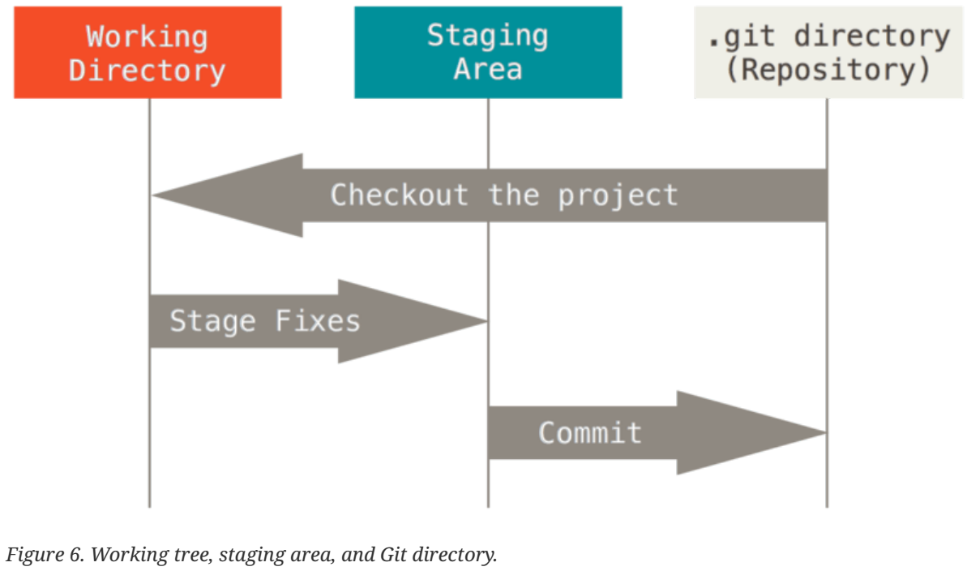
Figure 6

Slide 28
The Command Line
There are a lot of different ways to use Git.
There are
the original command-line tools, and
there are many graphical user interfaces of varying capabilities
For this book, we will be using Git on the command line.
For one, the command line is the only place you can run all Git commands – most of the GUIs implement only a partial subset of Git functionality for simplicity.
If you know how to run the command-line version, you can probably also figure out how to run the GUI version, while the opposite is not necessarily true.
Also, while your choice of graphical client is a matter of personal taste, all users will have the command-line tools installed and available.
So we will expect you to know how to open Terminal in Mac or Command Prompt or Powershell in Windows.
If you don’t know what we’re talking about here, you may need to stop and research that quickly so that you can follow the rest of the examples and descriptions in this book.

Slide 29
Installing Git
Before you start using Git, you have to make it available on your computer.
Even if it’s already installed, it’s probably a good idea to update to the latest version.
You can either
install it as a package or
via another installer, or
download the source code and compile it yourself

Slide 30
NOTE
This book was written using Git version 2.0.0.
Though most of the commands we use should work even in ancient versions of Git, some of them might not or might act slightly differently if you’re using an older version.
Since Git is quite excellent at preserving backwards compatibility, any version after 2.0 should work just fine.

Slide 31
Installing on Linux

Slide 32
Installing on Mac

Slide 33
Installing on Windows
There are also a few ways to install Git on Windows.
The most official build is available for download on the Git website.
Just go to http://git-scm.com/download/win and the download will start automatically.
Note that this is a project called Git for Windows, which is separate from Git itself; for more information on it, go to https://git-for-windows.github.io/.
To get an automated installation you can use the Git Chocolatey package.
Note that the Chocolatey package is community maintained.
Another easy way to get Git installed is by installing GitHub for Windows.
The installer includes a command line version of Git as well as the GUI.
It also works well with Powershell, and sets up solid credential caching and sane CRLF settings.
We’ll learn more about those things a little later, but suffice it to say they’re things you want.
You can download this from the GitHub for Windows website, at http://windows.github.com.

Slide 34
Installing from Source

Slide 35
First-Time Git Setup
Now that you have Git on your system, you’ll want to do a few things to customize your Git environment.
You should have to do these things only once on any given computer; they’ll stick around between upgrades.
You can also change them at any time by running through the commands again.
Git comes with a tool called git config that lets you get and set configuration variables that control all aspects of how Git looks and operates.
These variables can be stored in three different places:
/etc/gitconfig file: Contains values applied to every user on the system and all their repositories.
If you pass the option --system to git config, it reads and writes from this file specifically. (Because this is a system configuration file, you would need administrative or superuser privilege to make changes to it.)
~/.gitconfig or ~/.config/git/config file: Values specific personally to you, the user.
You can make Git read and write to this file specifically by passing the --global option.
config file in the Git directory (that is, .git/config) of whatever repository you’re currently using: Specific to that single repository.

Slide 36
First-Time Git Setup |
Each level overrides values in the previous level,
so values in .git/config trump those in /etc/gitconfig.
On Windows systems, Git looks for the .gitconfig file in the $HOME directory (C:\Users\$USER for most people).
It also still looks for /etc/gitconfig, although it’s relative to the MSys root, which is wherever you decide to install Git on your Windows system when you run the installer.
If you are using version 2.x or later of Git for Windows, there is also a system-level config file at
C:\Documents and Settings\All Users\Application Data\Git\config on Windows XP, and
in C:\ProgramData\Git\config on Windows Vista and newer.
This config file can only be changed by git config -f <file> as an admin.

Slide 37

Your Identity
The first thing you should do when you install Git is to set your
user name and
email address
This is important because every Git commit uses this information, and it’s immutably baked into the commits you start creating:
Again, you need to do this only once if you pass the --global option, because then Git will always use that information for anything you do on that system.
If you want to override this with a different name or email address for specific projects, you can run the command without the --global option when you’re in that project.
Many of the GUI tools will help you do this when you first run them.

Slide 38
Your Editor
Now that your identity is set up, you can configure the default text editor that will be used when Git needs you to type in a message.
If not configured, Git uses your system’s default editor.
If you want to use a different text editor, such as Emacs, you can do the following:
On a Windows system, if you want to use a different text editor, you must specify the full path to its executable file.
This can be different depending on how your editor is packaged.
In the case of Notepad++, a popular programming editor, you are likely to want to use the 32-bit version, since at the time of writing the 64-bit version doesn’t support all plug-ins.
If you are on a 32-bit Windows system, or you have a 64-bit editor on a 64-bit system, you’ll type something like this:

Slide 39
Your Editor |
If you have a 32-bit editor on a 64-bit system, the program will be installed in C:\Program Files (x86):

Slide 40

NOTE
Vim, Emacs and Notepad++ are popular text editors often used by developers on Unix-based systems like Linux and macOS or a Windows system.
If you are not familiar with these editors, you may need to search for specific instructions for how to set up your favorite editor with Git.
You may find, if you don’t setup your editor like this, you get into a really confusing state when Git attempts to launch it.
An example on a Windows system may include a prematurely terminated Git operation during a Git initiated edit.
Since Git might read the same configuration variable value from more than one file, it’s possible that you have an unexpected value for one of these values and you don’t know why.
In cases like that, you can query Git as to the origin for that value, and it will tell you which configuration file had the final say in setting that value:

Slide 41
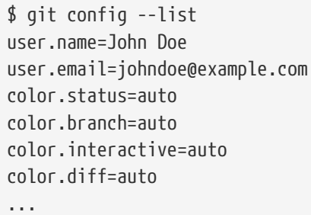

Checking your settings
If you want to check your configuration settings, you can use the git config --list command to list all the settings Git can find at that point:
You may see keys more than once, because Git reads the same key from different files (/etc/gitconfig and ~/.gitconfig, for example).
In this case, Git uses the last value for each unique key it sees.
You can also check what Git thinks a specific key’s value is by typing git config <key>:

Slide 42


Getting Help
If you ever need help while using Git, there are two equivalent ways to get the comprehensive manual page (manpage) help for any of the Git commands:
For example, you can get the manpage help for the git config command by running
These commands are nice because you can access them anywhere, even offline.
If the manpages and this book aren’t enough and you need in-person help, you can try the #git or #github channel on the Freenode IRC server (irc.freenode.net).
These channels are regularly filled with hundreds of people who are all very knowledgeable about Git and are often willing to help.
In addition, if you don’t need the full-blown manpage help, but just need a quick refresher on the available options for a Git command, you can ask for the more concise “help” output with the -h or --help options, as in Listing 1.

Slide 43
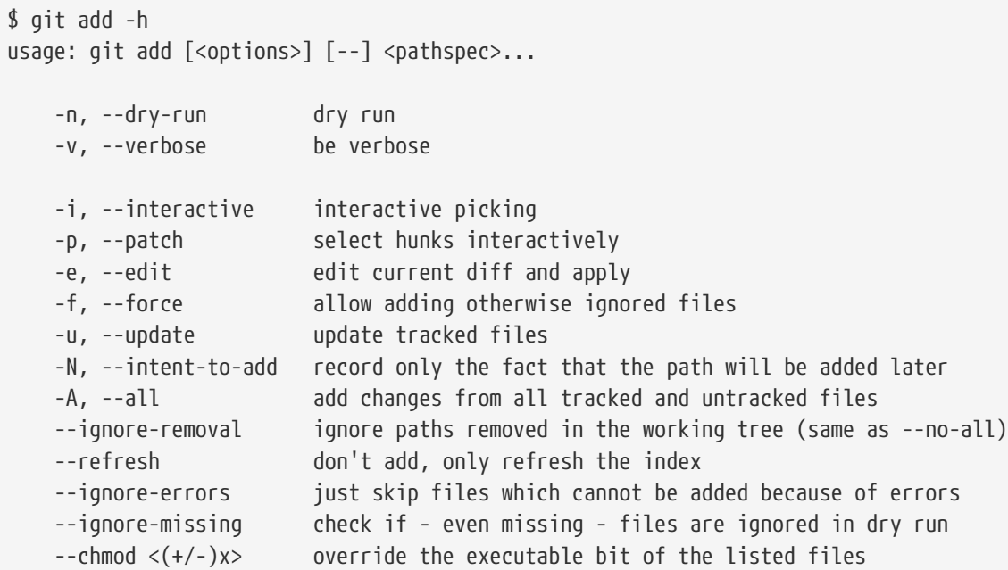
Listing 1

Slide 44
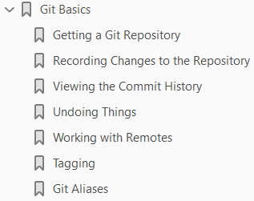
Git Basics
2

Slide 45
Intro
If you can read only one chapter to get going with Git, this is it.
This chapter covers every basic command you need to do the vast majority of the things you’ll eventually spend your time doing with Git.
By the end of the chapter, you should be able to
configure and initialize a repository,
begin and stop tracking files
stage and commit changes
We’ll also show you
how to set up Git to ignore certain files and file patterns
how to undo mistakes quickly and easily
how to browse the history of your project and view changes between commits, and
how to push and pull from remote repositories

Slide 46
Getting a Git Repository
You typically obtain a Git repository in one of two ways:
You can take a local directory that is currently not under version control, and turn it into a Git repository
You can clone an existing Git repository from elsewhere.
In either case, you end up with a Git repository on your local machine, ready for work.

Slide 47
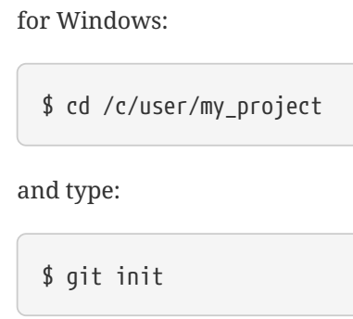
Initializing a Repository - Existing Directory
If you have a project directory that is currently not under version control and you want to start controlling it with Git, you first need to go to that project’s directory.
If you’ve never done this, it looks a little different depending on which system you’re running:
This creates a new subdirectory named .git that contains all of your necessary repository files — a Git repository skeleton.
At this point, nothing in your project is tracked yet. (See Git Internals for more information about exactly what files are contained in the .git directory you just created.)
If you want to start version-controlling existing files (as opposed to an empty directory), you should probably begin tracking those files and do an initial commit.

Slide 48
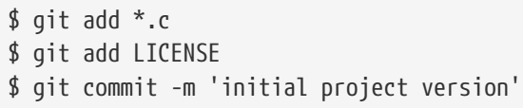
Initializing a Repository - Existing Directory |
You can accomplish that with a few git add commands that specify the files you want to track, followed by a git commit:
We’ll go over what these commands do in just a minute.
At this point, you have a Git repository with tracked files and an initial commit.

Slide 49
Cloning an Existing Repository
If you want to get a copy of an existing Git repository — for example, a project you’d like to contribute to — the command you need is git clone.
If you’re familiar with other VCS systems such as Subversion, you’ll notice that the command is "clone" and not "checkout".
This is an important distinction — instead of getting just a working copy, Git receives a full copy of nearly all data that the server has.
Every version of every file for the history of the project is pulled down by default when you run git clone.
In fact, if your server disk gets corrupted, you can often use nearly any of the clones on any client to set the server back to the state it was in when it was cloned (you may lose some server-side hooks and such, but all the versioned data would be there — see Getting Git on a Server for more details).
You clone a repository with git clone <url>.
For example, if you want to clone the Git linkable library called libgit2, you can do so like this:
That creates a directory named libgit2, initializes a .git directory inside it, pulls down all the data for that repository, and checks out a working copy of the latest version.

Slide 50
Cloning an Existing Repository |
If you go into the new libgit2 directory that was just created, you’ll see the project files in there, ready to be worked on or used.
If you want to clone the repository into a directory named something other than libgit2, you can specify that as the next command-line option:
That command does the same thing as the previous one, but the target directory is called mylibgit.
Git has a number of different transfer protocols you can use.
The previous example uses the https://protocol, but you may also see git:// or user@server:path/to/repo.git, which uses the SSH transfer protocol.
Getting Git on a Server will introduce all of the available options the server can set up to access your Git repository and the pros and cons of each.

Slide 51
Recording Changes to the Repository
At this point, you should have a bona fide Git repository on your local machine, and a checkout or working copy of all of its files in front of you.
Typically, you’ll want to start making changes and committing snapshots of those changes into your repository each time the project reaches a state you want to record.
Remember that each file in your working directory can be in one of two states:
tracked or
Untracked
Tracked files are files that were in the last snapshot; they can be
Unmodified
modified, or
Staged
In short, tracked files are files that Git knows about.
Untracked files are everything else — any files in your working directory that were not in your last snapshot and are not in your staging area.
When you first clone a repository, all of your files will be tracked and unmodified because Git just checked them out and you haven’t edited anything.

Slide 52
Recording Changes to the Repository |
As you edit files, Git sees them as modified, because you’ve changed them since your last commit.
As you work, you selectively stage these modified files and then commit all those staged changes, and the cycle repeats.

Slide 53
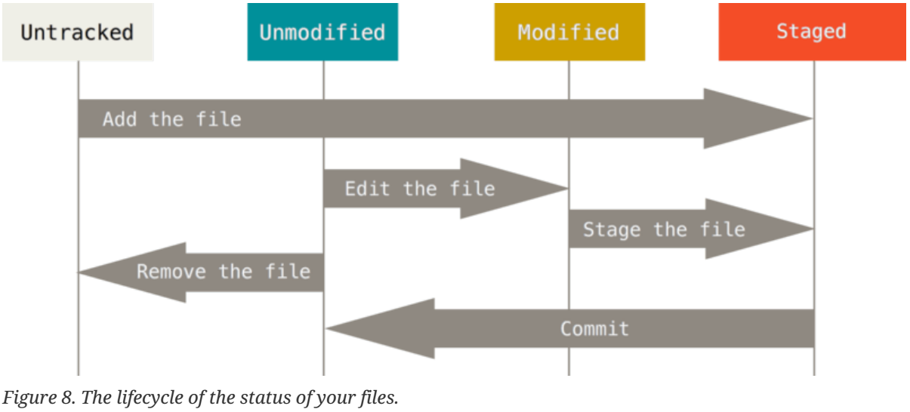
Figure 8

Slide 54
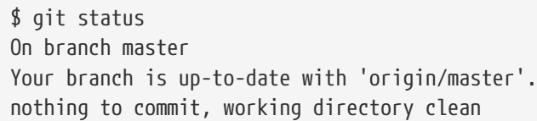
Checking the Status of Your Files
The main tool you use to determine which files are in which state is the git status command.
If you run this command directly after a clone, you should see something like this:
This means you have a clean working directory — in other words, none of your tracked files are modified.
Git also doesn’t see any untracked files, or they would be listed here.
Finally, the command tells you which branch you’re on and informs you that it has not diverged from the same branch on the server.
For now, that branch is always “master”, which is the default; you won’t worry about it here.
Git Branching will go over branches and references in detail.

Slide 55
Adding Files
Let’s say you add a new file to your project, a simple README file.
If the file didn’t exist before, and you run git status, you see your untracked file like so: Listing 8-0.
You can see that your new README file is untracked, because it’s under the “Untracked files” heading in your status output.
Untracked basically means that Git sees a file you didn’t have in the previous snapshot (commit); Git won’t start including it in your commit snapshots until you explicitly tell it to do so.
It does this so you don’t accidentally begin including generated binary files or other files that you did not mean to include.
You do want to start including README, so let’s start tracking the file.

Slide 56
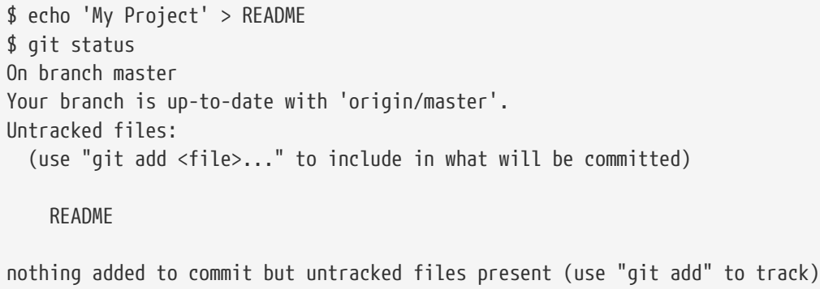
Listing 8-0

Slide 57

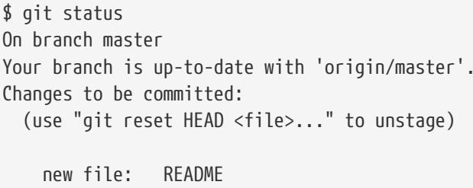
Tracking New Files
In order to begin tracking a new file, you use the command git add.
To begin tracking the README file, you can run this:
If you run your status command again, you can see that your README file is now tracked and staged to be committed:
You can tell that it’s staged because it’s under the “Changes to be committed” heading.
If you commit at this point, the version of the file at the time you ran git add is what will be in the historical snapshot.
You may recall that when you ran git init earlier, you then ran git add <files> — that was to begin tracking files in your directory.
The git add command takes a path name for either a file or a directory; if it’s a directory, the command adds all the files in that directory recursively.

Slide 58
Staging Modified Files
Let’s change a file that was already tracked.
If you change a previously tracked file called CONTRIBUTING.md and then run your git status command again, you get something that looks like this:
(Page 27).

Slide 59
Short Status
While the git status output is pretty comprehensive, it’s also quite wordy. Git also has a short status flag so you can see your changes in a more compact way. If you run git status -s or git status --short you get a far more simplified output from the command:
(Page 28).

Slide 60
Ignoring Files
Often, you’ll have a class of files that you don’t want Git to automatically add or even show you as being untracked. These are generally automatically generated files such as log files or files produced by your build system. In such cases, you can create a file listing patterns to match them named .gitignore. Here is an example .gitignore file:
(Page 29).

Slide 61
Viewing Your Staged and Unstaged Changes
If the git status command is too vague for you — you want to know exactly what you changed, not just which files were changed — you can use the git diff command. We’ll cover git diff in more detail later, but you’ll probably use it most often to answer these two questions: What have you changed but not yet staged? And what have you staged that you are about to commit? Although git status answers those questions very generally by listing the file names, git diff shows you the exact lines added and removed — the patch, as it were. Let’s say you edit and stage the README file again and then edit the CONTRIBUTING.md file without staging it. If you run your git status command, you once again see something like this:
(Page 30).

Slide 62
Committing Your Changes
Now that your staging area is set up the way you want it, you can commit your changes. Remember that anything that is still unstaged — any files you have created or modified that you haven’t run git add on since you edited them — won’t go into this commit. They will stay as modified files on your disk. In this case, let’s say that the last time you ran git status, you saw that everything was staged, so you’re ready to commit your changes. The simplest way to commit is to type git commit:
(Page 33).

Slide 63
Skipping the Staging Area
Although it can be amazingly useful for crafting commits exactly how you want them, the staging area is sometimes a bit more complex than you need in your workflow. If you want to skip the staging area, Git provides a simple shortcut. Adding the -a option to the git commit command makes Git automatically stage every file that is already tracked before doing the commit, letting you skip the git add part:
(Page 34).

Slide 64
Removing Files
To remove a file from Git, you have to remove it from your tracked files (more accurately, remove it from your staging area) and then commit. The git rm command does that, and also removes the file from your working directory so you don’t see it as an untracked file the next time around. If you simply remove the file from your working directory, it shows up under the “Changes not staged for commit” (that is, unstaged) area of your git status output:
(Page 35).

Slide 65
Moving Files
Unlike many other VCS systems, Git doesn’t explicitly track file movement. If you rename a file in Git, no metadata is stored in Git that tells it you renamed the file. However, Git is pretty smart about figuring that out after the fact — we’ll deal with detecting file movement a bit later. Thus it’s a bit confusing that Git has a mv command. If you want to rename a file in Git, you can run something like:
(Page 36).

Slide 66
Viewing the Commit History
After you have created several commits, or if you have cloned a repository with an existing commit history, you’ll probably want to look back to see what has happened. The most basic and powerful tool to do this is the git log command. These examples use a very simple project called “simplegit”. To get the project, run
(Page 37).

Slide 67
Undoing Things
At any stage, you may want to undo something. Here, we’ll review a few basic tools for undoing changes that you’ve made. Be careful, because you can’t always undo some of these undos. This is one of the few areas in Git where you may lose some work if you do it wrong. One of the common undos takes place when you commit too early and possibly forget to add some files, or you mess up your commit message. If you want to redo that commit, make the additional changes you forgot, stage them, and commit again using the --amend option:
(Page 44).

Slide 68
Working with Remotes
To be able to collaborate on any Git project, you need to know how to manage your remote repositories. Remote repositories are versions of your project that are hosted on the Internet or network somewhere. You can have several of them, each of which generally is either read-only or read/write for you. Collaborating with others involves managing these remote repositories and pushing and pulling data to and from them when you need to share work. Managing remote repositories includes knowing how to add remote repositories, remove remotes that are no longer valid, manage various remote branches and define them as being tracked or not, and more. In this section, we’ll cover some of these remote-management skills.
(Page 47).

Slide 69
Tagging
Like most VCSs, Git has the ability to tag specific points in history as being important. Typically people use this functionality to mark release points (v1.0, and so on). In this section, you’ll learn how to list the available tags, how to create new tags, and what the different types of tags are.
(Page 52).

Slide 70
Git Aliases
Before we finish this chapter on basic Git, there’s just one little tip that can make your Git experience simpler, easier, and more familiar: aliases. We won’t refer to them or assume you’ve used them later in the book, but you should probably know how to use them. Git doesn’t automatically infer your command if you type it in partially. If you don’t want to type the entire text of each of the Git commands, you can easily set up an alias for each command using git config. Here are a couple of examples you may want to set up:
(Page 57).

Slide 71
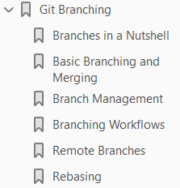
3
Git Branching

Slide 73
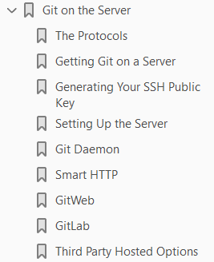
4
Git on the Server

Slide 74
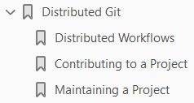
5
Distributed Git

Slide 75
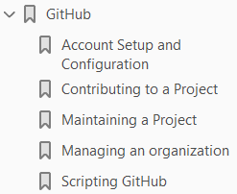
6
GitHub

Slide 76
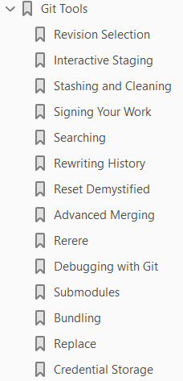
7
Git Tools

Slide 77
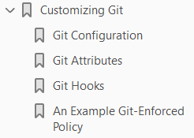
8
Customizing Git

Slide 78

9
Git and Other Systems

Slide 79
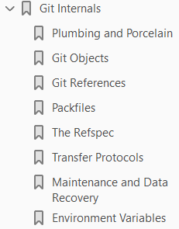
10
Git Internals

Slide 80
Popular VCS Tools

Slide 81
Popular VCS Tools
Consider the below table:
SVN | Type | Release Date | Developer (s)
Revision Control System | Local VCS | 1982 | Walter F. Tichy
Git | Distributed VCS | 7 Apr 2005 | Linus Torvalds
Apache Subversion | Centralized VCS | Feb 2004
Team Foundation Server | Distributed VCS | 2005
CVS | Centralized VCS
Perforce | Centralized VCS
Mercurial | Distributed VCS
Bazaar | Distributed VCS
Darcs | Distributed VCS

